Slide 1
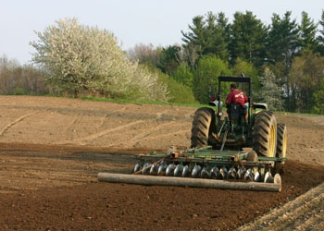
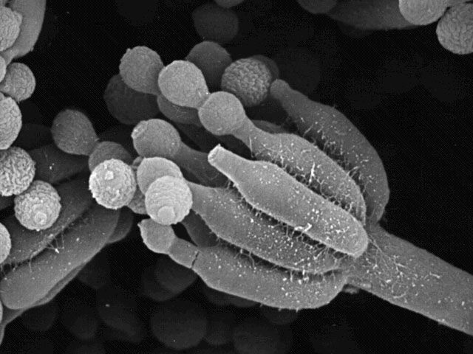
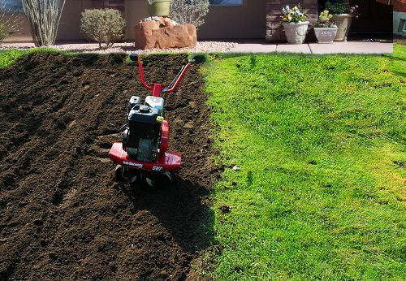
Microbes in soil
P. Neelamanie Yapa
Faculty of Applied Sciences
Rajarata University of
Sri Lanka

Slide 2
Learning Outcomes are to:
describe morphological indications of different soil microorganisms;
identify the representatives of the main soil microorganism groups;
understand the course of microbiological processes and know their main agents
Identify activity and interactions of different microorganisms in soil
use of microorganisms in improving soil health.

Slide 3
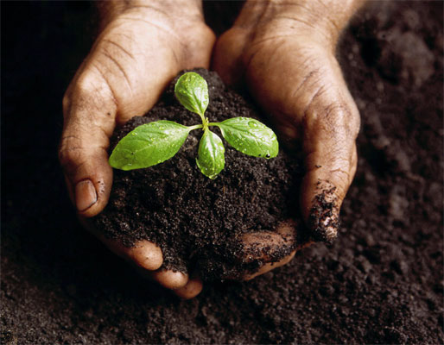
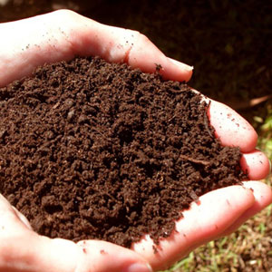
Soil
Soils correspond to the surface layer of
the Earth's crust
(lithosphere: litho = rock).
They develop as a result of the
weathering of geological rock
formations.

Slide 4
Soils Defined
Natural Body that Occurs on the land Surface
Consists of Distinct Horizons or Layers
The ability to support rooted plants in a natural environment
Upper Limit is Air or Shallow Water
Lower Limit is Bedrock or Limit of Biological Activity
Classification based on a typical depth of 2 m or approximately 6.0 feet

Slide 5
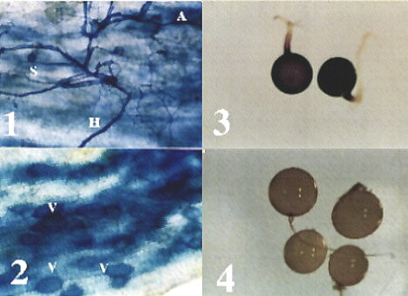
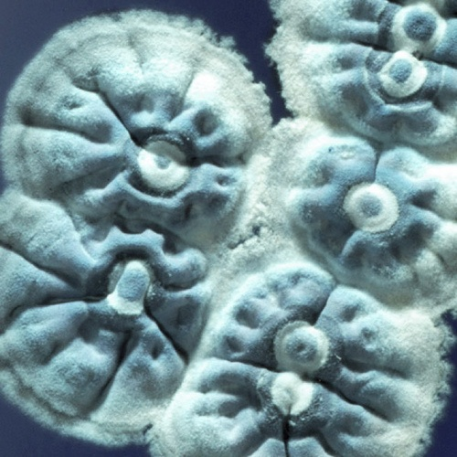
Soil microbiology
They are found in association with air (i.e. the soil atmosphere) and an aqueous phase (i.e. the soil solution) in the pores
existing between particles
and/or aggregates.

Slide 6
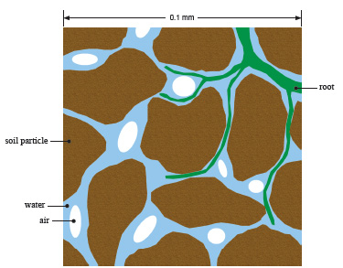
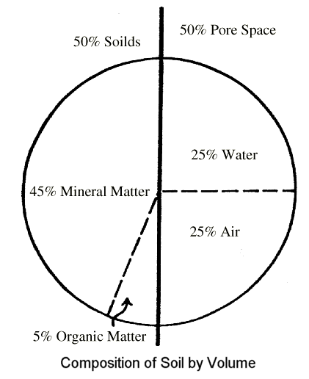
Soil Composition
Constantly changing
Mineral
rock derivative
Pore space
water
air
Organic Matter
plant and animal matter
living and dead

Slide 7
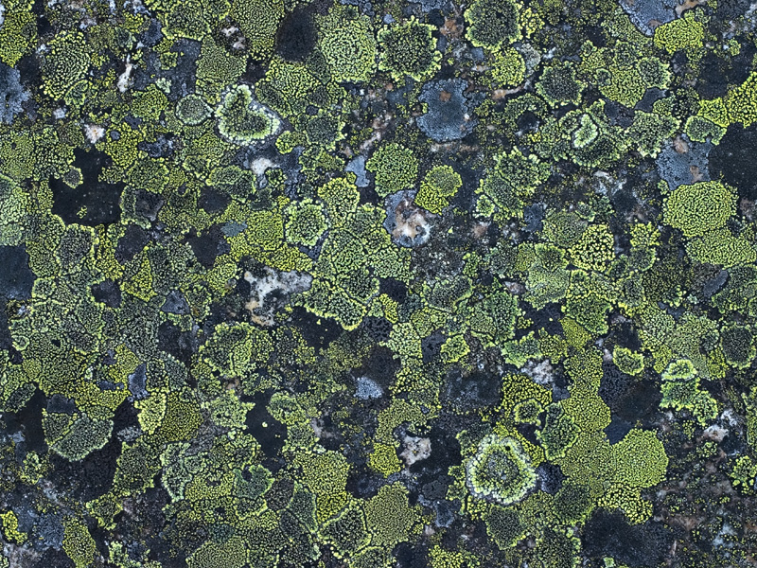
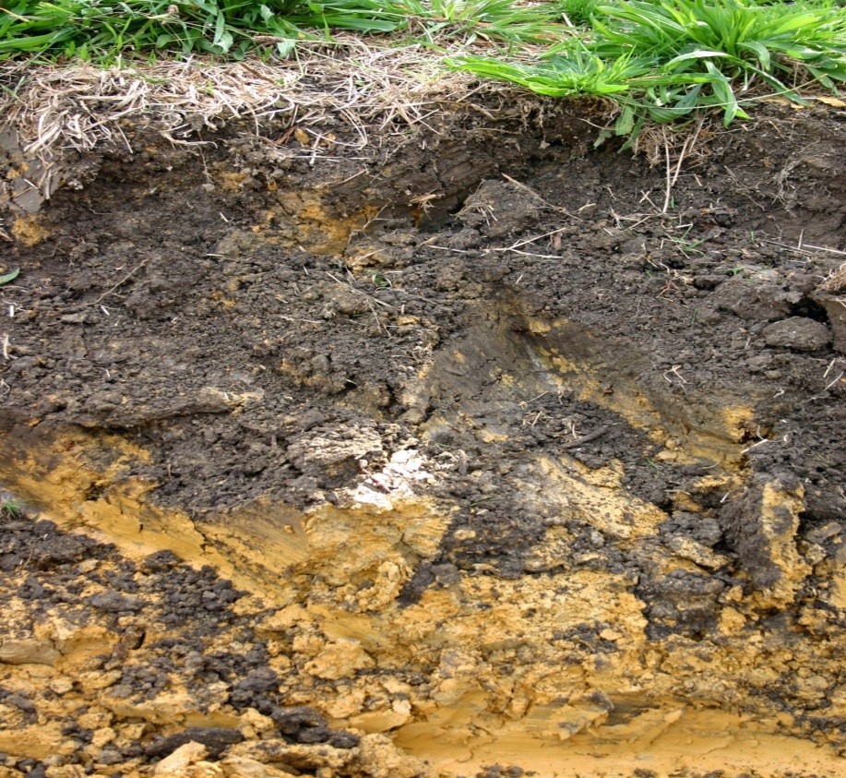
Five Soil Formation Factors
Organisms
Climate
Time
Topography and Landscape Setting
Parent Material
R
Point: Soils are Created in Geological Time, but can be destroyed in a very short time

Slide 8
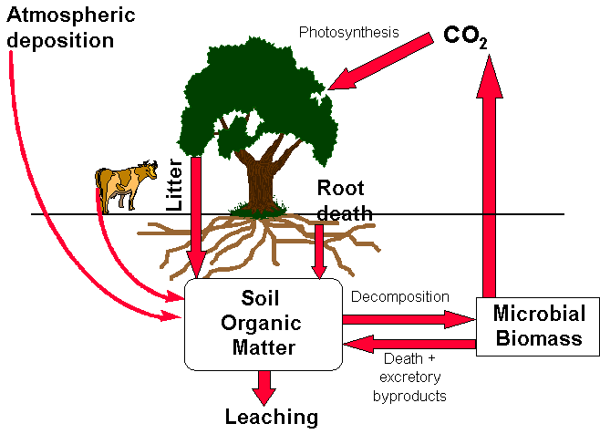
Soil Organic Matter
Composition
Carbon Cycle
living and dead
plant and animal
dynamic system
Advantages
Improves structure
increased infiltration
increased water holding capacity
increased workability
increased CEC
OM has high number of exchange sites

Slide 9
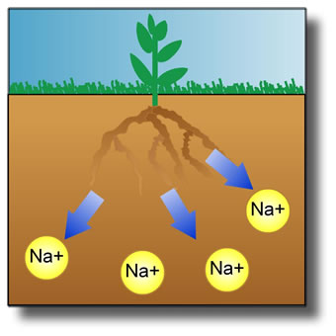
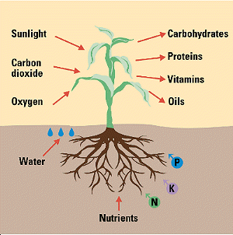
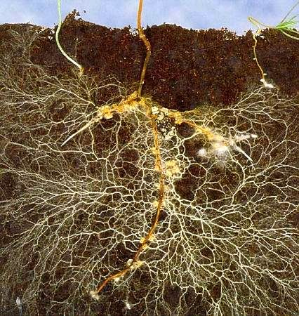
Chemical Properties
Soil pH
Cation Exchange Capacity
Organic matter content
Clay mineralogy
Essential Plant Nutrients
Nutrient Movement
Root/soil interaction

Slide 10
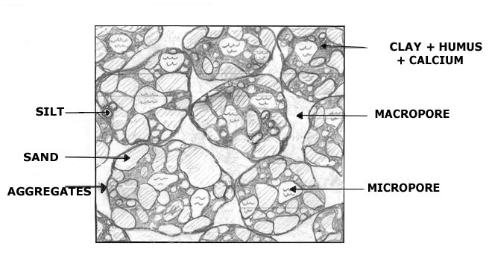
Types of Pores
Macropores (> 1,000 microns)- large
Mesopores (10 to 1,000 microns)- Medium
Micropores (< 10 microns)- Small

Slide 11
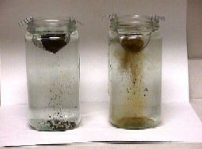
Water Stable Aggregates
Aggregates on left are more water stable, i.e., aggregate stays together and do not separate into the its components,
Water Stable Aggregates

Slide 12
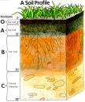
Soil Horizons
Layer of Soil Parallel to Surface
Properties a function of climate, landscape setting, parent material, biological activity, and other soil forming processes.
Horizons (A, E, B, C, R, etc)
Image Source: University of Texas, 2002

Slide 13
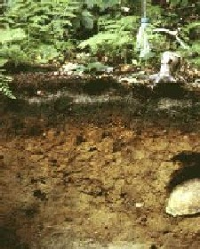
Soil Horizons O- Organic Horizons
Organic Layers of Decaying Plant and Animal Tissue
Aids Soil Structural Development
Helps to Retain Moisture
Enriches Soil with Nutrients
Infiltration Capacity function of Organic Decomposition
Organic Matter Critical in Maintaining Water Stable Peds
O Horizon
Dark in Color Because of Humus Material - 1,000,000 bacteria per cm3

Slide 14
Soil Horizons A Horizons: “ Topsoil”
Mineral Horizon Near Surface
Moves Humic and Minerals from O Horizon into A horizon
Soil dark in color, coarser in texture, and high porosity
A Horizon

Slide 15
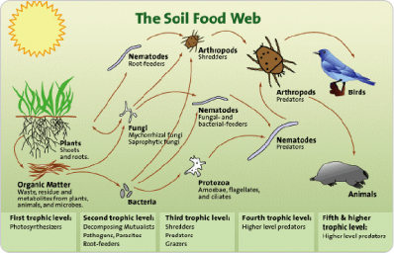

Slide 16
Soil - a favorable habitat for microorganisms
inhabited by a wide range of microorganisms, including bacteria, fungi, algae, viruses and protozoa.
Microorganisms are found in large numbers in soil - usually between one and ten million microorganisms are present per gram of soil.

Slide 17
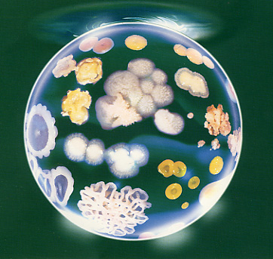
Bacteria and fungi being the most prevalent.
However, the availability of nutrients is often limiting for microbial growth in soil and most soil microorganisms may not be physiologically active in the soil at a given time.

Slide 18
Microorganisms and their significance:
Almost every chemical transformation taking place in soil involves active contributions from soil microorganisms.
Active role in soil fertility as a result of their
involvement in the cycle of nutrients like carbon and nitrogen, which are required for plant growth.

Slide 19
Microorganisms and their significance:
Responsible for the decomposition of the organic matter entering the soil and therefore in the recycling of nutrients in soil.
Certain soil microorganisms such as mycorrhizal fungi can also increase the availability of mineral nutrients (e.g. phosphorus) to plants.

Slide 20
Microorganisms and their significance:
Can increase the amount of nutrients present in the soil.
The microorganisms, which improve the fertility status of the soil and contribute to plant growth, have been termed ‘biofertilizers’.

Slide 21
Microorganisms and their significance:
Soil microorganisms produce compounds
(such as vitamins and plant hormones) that can improve plant health and contribute to higher crop yield.
‘Phytostimulators’ are currently studied for
possible use as microbial inoculants to improve crop yield.

Slide 22
Microorganisms and their significance:
Some soil microorganisms are pathogenic to
plants. Large numbers are routinely found in
the soil and many of them can infect the plant
through the roots.

Slide 23
Microorganisms and their significance:
Antagonistic to the pathogens and can
prevent the infection of crop plants.
– Competition for nutrients and/or production
of inhibitory compounds such as secondary
metabolites (antimicrobial metabolites and
antibiotics) and extracellular enzymes.

Slide 24
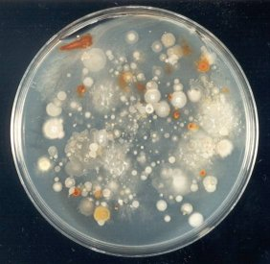
Major groups of soil microorganisms :
Bacteria:
Numerically abundant
Along with fungi, most important decomposers of organic matter

Slide 25
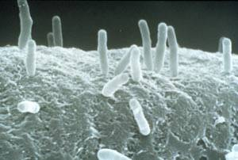
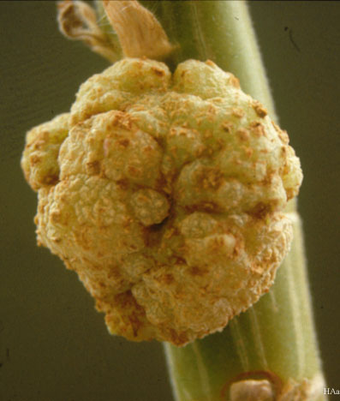
Major groups of soil microorganisms :
Bacteria:
Specialized groups participate in all
biogeochemical cycles
Their extracellular polymers help bind soil
particles into aggregates
Some form beneficial or
pathogenic interactions with plants

Slide 26
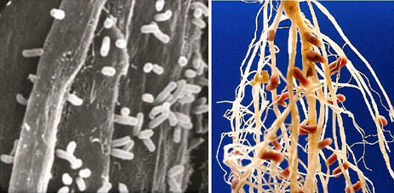
Major groups of soil microorganisms :
Nitrogen fixing organisms: bacteria

Slide 27
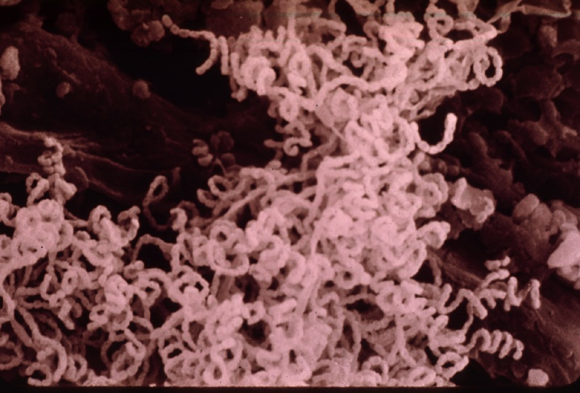
Major groups of soil microorganisms :
Actinomycetes:
– specialized filamentous prokaryotes
– participate in decomposition of complex organic compounds
– produce many 2nd metabolites, e.g., antibiotics, geosmins (earth odor) that give soil its characteristic distinctive aroma

Slide 28
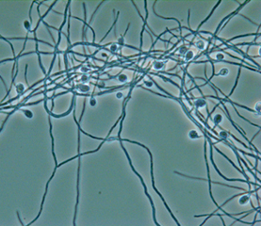
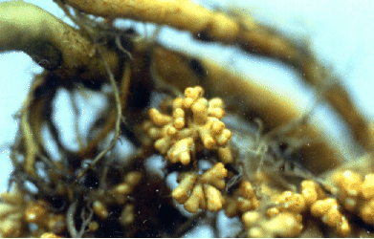
Frankia and actinorrhizal plant
Symbiosis

Slide 29
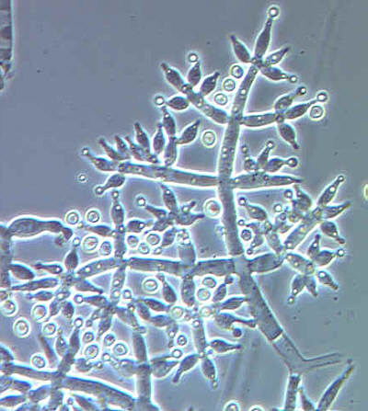
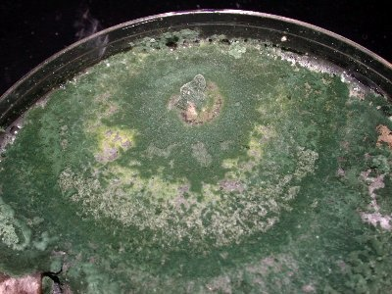
Major groups of soil microorganisms :
Fungi:
– the major component of microbial biomass in soils
– major participants in decomposition of
organic matter
– hyphal growth helps bind soil particles into stable aggregates.

Slide 30
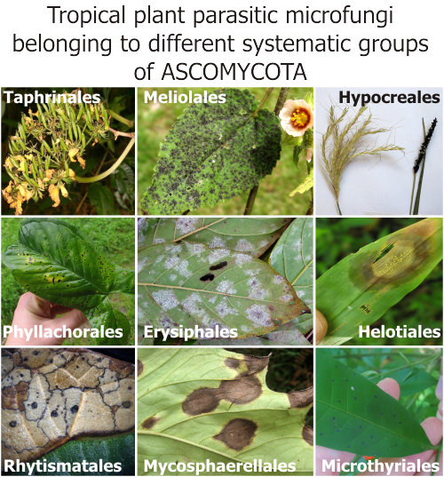
Plant communities are closely associated with fungal and bacterial communities in their soil

Slide 31
Major groups of soil microorganisms :
Fungi:
– Some associate with plant roots: major plant
pathogens,
– Beneficial symbionts
increase nutrient uptake and decrease disease incidence

Slide 32
Major groups of soil microorganisms :
Cyanobacteria and algae (green algae,
diatoms):
– Photoautotrophs, form surface algal crusts
important in H2O retention
– Some cyanobacteria carry out free-living and
symbiotic N2-fixation

Slide 33
Major groups of soil microorganisms :
Viruses: - Numerically abundant, ecology not well
defined
–bacteriophage
– Persistance and migration of human
enteroviruses pose serious health issues with
land disposal of sewage and fecal wastes

Slide 34
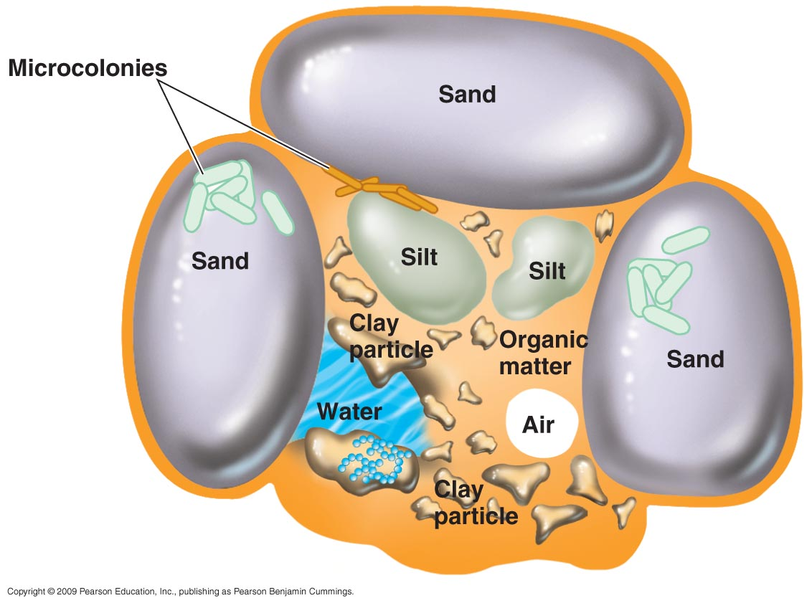
Terrestrial Environments
Most microbial growth takes place on the surfaces of soil particles
Soil aggregates can contain many different microenvironments supporting the growth of several types of microbes

Slide 35
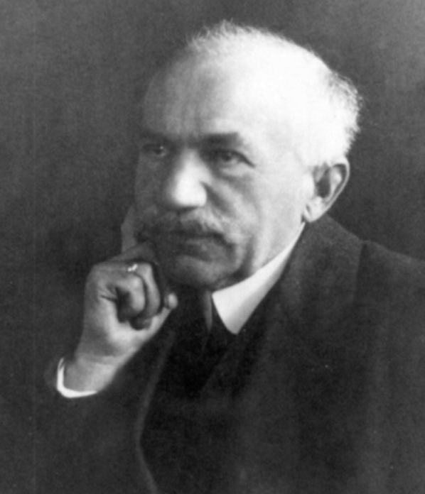
Rhizosphere: the Place to be in Soil
What is the Rhizosphere
Rhizo= Rhiza= root
Sphere= field or area of influence , physical location around the root
Introduced by Hiltner in 1904
the region surround plant roots
influence by root exudates
1-2 mm from root
variable region where the root production stimulate microbial population and activity

Slide 36
Rhizosphere
Comprised of different zones
Endorhizosphere
multi-layered microenvironment, which includes a mucoid layer on the root surface, the epidermal layer of the root tissue including the root hairs and the cortical cells
Ectorhizosphere
rhizosphere soil

Slide 37
Rhizosplane
It’s plant’s root surface (external surface) where many microorganism adhere to it.
1µm thick.
hard to distinguish between Rhizo sphere/ plane.
NonRhizosphere
Zone that not penetrated by plant root .
it has less microbial activity.

Slide 38
Rhizosphere vs NonRhizosphere
In the Rhizosphere:
More enhanced microbial growth
More soluble C, nutrients
Distance (µm) | Morphologically distinct microbe type | Numbers (x 10⁻⁹)
0-1 | 8 | 120
0-5 | 11 | 96
5-10 | 6 | 41
10-15 | 3 | 34
15-20 | 3 | 13
From the plant root
Foster (1986)

Slide 39


Organic material in rhizosphere
Exudates
low molecular weight compounds released from plant cells in a non-metabolic manner (leakage)
Secretions
compounds metabolically released from plant cells
Lysates
compounds released from cells during autolysis
Plant mucilage
plant polysacchrides

Slide 40
Densities of microorganisms in rhizosphere
Decreasing
microbial
diversity

Slide 41
Mucilage
Insoluble organic compounds of four different origins.
- mucilage secreted by Golgi organelles in the root cap cells.
- hydrolysates of the polysaccharides of the primary cell wall between epidermal cells of the primary wall and sloughed root cap call.
- mucilage secreted by epidermal cells and root hairs.
- mucilage produced by bacterial degradation of dead epidermal cells.

Slide 42
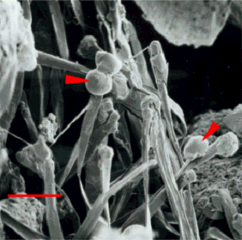
Root exudates
Low molecular weight compounds.
Act as a messengers
Energy for microbes
Root exudates as drops on root surface

Slide 43
Root exudates function
Defend the rhizosphere and root against pathogenic microorganism
Attract greater number of microorganism
Keep the soil around the root moist
Obtain nutrients
Change the chemical properties of the soil around the root
Inhibit the growth of competing plant species

Slide 44
Enzymes in the rhizosphere
Enzymes activity greater in rhizosphere than in bulk soil
Wide range of enzymes ( plant- microorganism)
-Oxidoreductases (transfer of electrons from one molecule to another)
-Hydrolases (nutrient mineralization, protein breakdown)
-Lyases (degrades cell wall and membrane of bacteria and fungi)
-Transferases(transfer a functional group from one molecule to another)
Enzymes catalyze the breakdown of
- organic material (cellulases, dehydrogenases)
- fertilizers (ureases)
- organic nutrients (phosphatases, sulfatases)

Slide 45
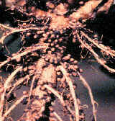
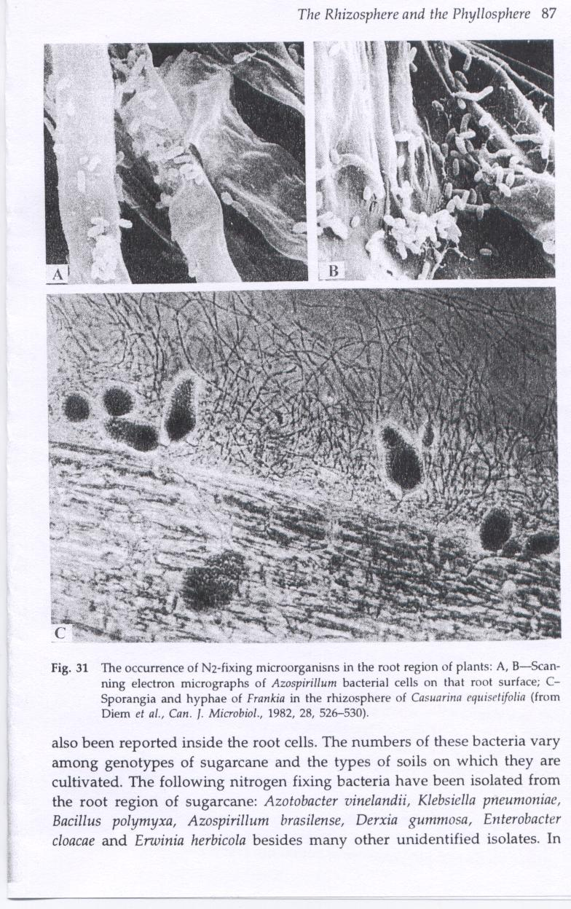
Some function of Bacteria in rhizosphere
Bacteria N2 fixation
Rhizobium,Bradyrhizobium with legumes
Azospirillum on roots surface of grass
Frankia with nonleguminous angiosperms
Rhizobium
Frankia
Azospirillum

Slide 46
Some function of Bacteria in rhizosphere
Bacteria has role in P cycle in the rhizosphere
Solubilization of inorganic phosphorus (P dissolving bacteria) Pseudomonas, Bacillus
Reduce pH by secret organic acids (formic, acetic, lactic acid)

Slide 47
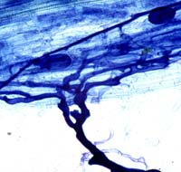
Mycorrhizal fungi
Beneficial fungi associate with plant root
~ 90 % of plant count on mycorrhizal fungi root system
nutrient exchange
carbohydrate
plant
mycorrhiza
nutrients
hyphae
Vesicular Arbuscular

Slide 48
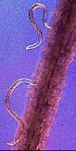
Microorganism in rhizosphere
Nematodes
Up to 83% soil nematodes are root feeders (herbivores)
Nematode activity stimulate by substances in Rhizosphere ( CO₂, ethylene- amino acids- salts- mucigel)
Lavelle et al., 2001

Slide 49
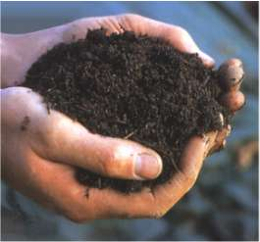
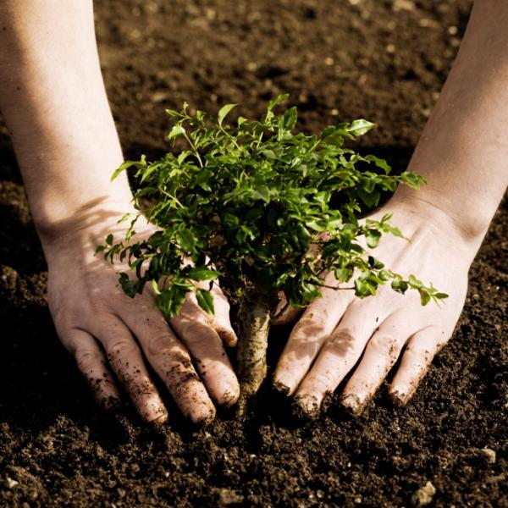
SOIL BIOLOGICAL PROCESSES
Decomposition of Organic Matter

Slide 50
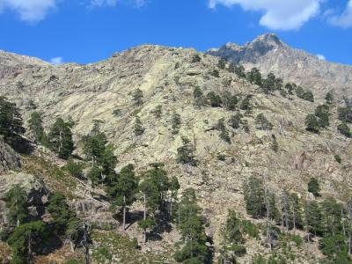
Weathering of rocks : biological weathering/ microorganisms helps weathering
The major fungi involved in weathering –
taxonomic and ecological perspectives
In the fungal phyla Ascomycota, Basidiomycota, and Zygomycota, important functional groups of fungi with potential weathering capabilities can be recognized.

Slide 51
Lichen-forming fungi. Lichens, associations between
fungi and algae or cyanobacteria, date at least from the early Devonian (400 million years ago).
Lichens have played an important role in rock
weathering and soil development (Chen et al. 2000).
Because the associated fungus is closer to the mineral interface than the plant, the weathering ability of lichens is most probably due mainly to the fungus.

Slide 52
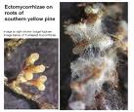
Mycorrhizal fungi, especially ectomycorrhizal
(sheathing mycorrhizal) and ericoid mycorrhizal fungi, which were recognized recently as potentially important for mineral weathering (Lndeweert et al. 2001).

Slide 53
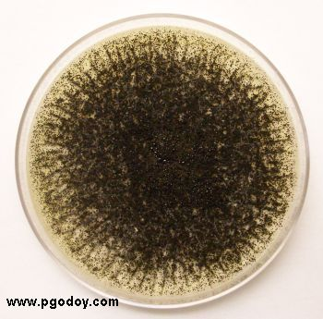
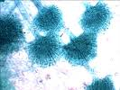
Saprotrophic fungi, Aspergillus niger which use relatively simple carbohydrate sources and quickly proliferate under favorable conditions.

Slide 54
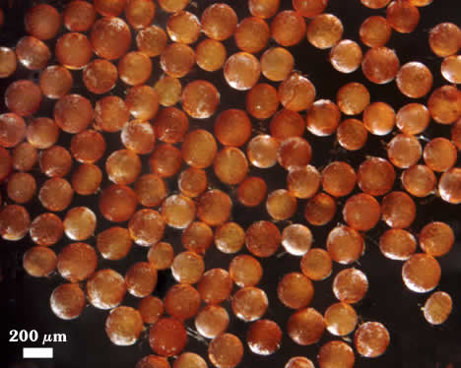

Saprotrophic organisms that use the lignocellulose complex.
White rot and brown rot fungi produce large amounts of organic anions (especially oxalate) that
they use for generating hydrogen peroxide and for the production of Mn chelates that can oxidize a range of phenolic compounds may therefore be potential weathering agents.

Slide 55
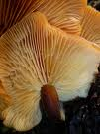
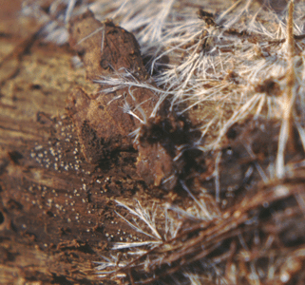
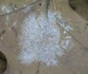
How do fungi weather rocks and minerals?
Fungi can penetrate solid materials using both physical and chemical tools. The mycelial growth form allows fungi to exploit weak spots on the rock or grain surface.

Slide 56

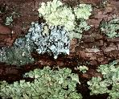
Lichen compounds. “Lichen acids”, produced by the fungal
partner in the lichen symbiosis, have for a long time been recognized as the major weathering components of lichens growing on rocks.
Furthermore, lichen compounds are usually concentrated in the upper thallus, at the fungal–algal or cyanobacterial interface, not at the mineral interface.
In the field, metal–lichen–acid complexes
have very rarely been reported,
suggesting they play a limited role
in weathering.

Slide 57
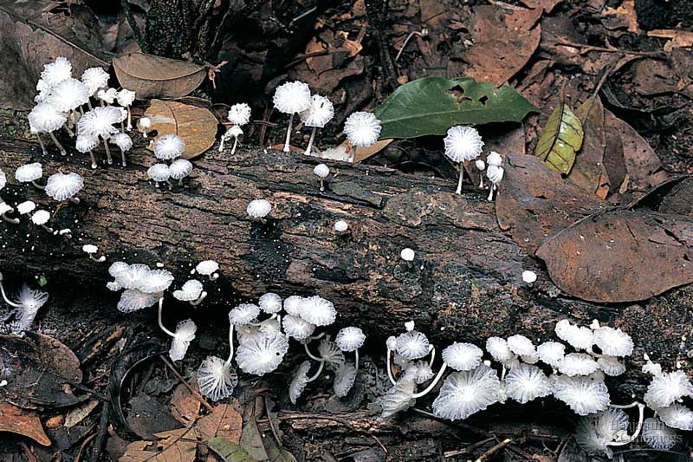


Decomposition and soil organic matter

Slide 58

Litter Decomposition

Slide 59
Plant Litter Decomposition
3 phases:
Leaching by water. Removes soluble materials (nutrients, simple C compounds)
222.Fragmentation by soil animals.
3 Chemical alteration. Changes chemical
composition of detritus.

Slide 60
The role of microbes: phase 3
Chemistry is altered as microbes break down
organic matter molecules
Compounds are decomposed at different rates,
new compounds are synthesized
Microbial activity controlled by:
Environment: soil T, H₂O, soil O₂
Substrate: chemical makeup of organic matter
Rate of microbial activity determines rate of C loss, nutrient release etc.
Rate of activity measured as organic matter mass loss.

Slide 61
Fungi
Fungi
Accounts for most aerobic decomposition
- 60-90% of microbial biomass in forests
- About half of microbial biomass in grassland
Broad enzymatic capability
- Cell walls (lignin, cellulose, hemicellulose)
- Cell contents (proteins, sugars, lipids)
Can transport metabolites through hyphae
Surface litter (import nitrogen from soil)
Wood degraders (import nitrogen from soil)

Slide 62
Bacteria
Grow rapidly on labile substrates
Some function anaerobically
Dependent on substrates that diffuse. Diffusion gradient caused by
Production of soluble substrates (enzymes)
Uptake of substrates by bacterium
Bacteria
Spatial specialists
Rhizosphere, macropores, interior of aggregates
form biofilms on particle surfaces
Chemical specialists
Different bacteria produce different enzymes

Slide 63

Plant Litter Decomposition

Slide 64
Organic matter in the soil
Organic matter is anything that contains carbon compounds that were formed by living organisms. Three main components are
Dead forms of organic material - mostly dead plant parts (85%)
living parts of plants - mostly roots (10%)
living microbes and soil animals
Partly decayed organic matter is called humus

Slide 65
Humus (Latin for soil)
A continuum of organic matter decomposition from fresh litter to well decomposed humus
Separation Schemes for operational definition
Chemical Separation
Fulvic acids- soluble in acid, base
Humic acids- soluble in base, not acid
Humins - not soluble in base or acid

Slide 66
Major steps in the degradation of organic matter
Involves 4 major steps
Breakdown of compounds that are easy to decompose (e.g. sugars, starches and proteins)
Breakdown of compounds that take several years to decompose (cellulose and lignin)
Breakdown of compounds that take 10 years (e.g. waxes and phenols)
Compounds that takes 100-1000’s of years (e.g. humus like substances, which are very complex)

Slide 67
Microbial degradation or organic matter
Involves complex processes. Chemical alteration of organic matter, physical fragmentation and release of mineral nutrients.
The dead organic matter is colonized by microbes and degraded with help of microbial enzymes.
Macromolecules are broken down into simpler units and further degraded into constituent elements.

Slide 68
Microbial degradation or organic matter..
Why do stems and leaves degrade at different rates?
Because they are made up of different kinds of molecules and require different enzymes.
E.g. Cellulose, predominant in leafy tissues are easily degradable than lignin, major component of wood.

Slide 69
Mineralization of organic matter
Mineralisation is the biological process where organic compounds in organic matter are chemically converted by the microorganisms in soil to simpler compounds, other organic compounds or mineralised nutrients.

Slide 70
Examples of tropical and temperate region plant-soil systems

Slide 71
Humification
1. Selective preservation -- plant waxes, cutins, suberin, lignin, chitin, microbial cell walls are hard to decompose & become enriched in soil
2 Microbial transformations -- enzymatic breakdown by microbes produces low molecular weight soluble compounds such as amino acids.
3. Polyphenol formation --phenols in soil are derived from lignin breakdown, soil microbial synthesis, and by plants as defensive compounds

Slide 72

Humification
4. Quinone formation -- conversion of polyphenols to reactive quinones as a result of extracellular enzymes
5. Abiotic condensation -- quinones react spontaneously with many soil compounds such as amino acids to form humus

Slide 73
What stimulates soil organic matter decomposition?
Usual suspects (changes in climate, nutrient availability, aeration)
Mechanical mixing/plowing
Plant species change
C additions “priming the pump”…
Soil weathering…?

Slide 74
SOIL FORMATION AND AGGREATION
Where are the microorganisms located in the soil?
Usually the top 2-3 cms.
Commonly found close to root surfaces, in dead roots, on soil particles or amongst aggregates of soil particles.
Soils that are clayey have many bacteria because these soils have lot of small pores.
Sandy soil is less suitable habitat.

Slide 75
Soil aggregates and soil pores
What are soil aggregates and soil pores?
Soil aggregates: Clumps of soil particles that are held together by moist clay, organic matter, gums (from bacteria and fungi) and by fungal hyphae.
Vary in size from 2 microns to 2 mm.
Soil pores: spaces between soil particles and soil aggregates.
They can be full of air or have water in them.
Very essential for storing air, water, microbes, nutrients and organic matter.

Slide 76
Bacterial/ Fungal role in the formation of soil aggregate
Two ways
Using bacterial polysaccharide as a gum
Through electrostatic charge between bacteria and clay surfaces
Fungi help form soil aggregates when fungal hyphae enmesh and cross link soil particles.
Mycorrhizae are very important in this process.

Slide 77



Biogeochemical Cycles and soil microbes

Slide 78

Water body

Slide 79
Nutrient Requirements for Plant Growth
Taken up in gaseous form, Oxygen (O₂), Carbon CO₂, and from roots - Water (H₂O).
Derived from water and carbon dioxide
Rest are taken up from soil solutions
Macro-nutrients –Nitrogen (N), Phosphorous (P), Potassium (K),
Calcium (Ca), Magnesium (Mg), Sulfur (S)
Micro-nutrients – Boron (B), Copper (Cu), Iron (Fe), Manganese (Mn), Molybdenum (Mo), Zinc (Zn)
Notes:
Plants require certain elements for growth
• Basic elements that are used in photosynthesis and respiration (Carbon, Oxygen) or are extracted directly from the atmosphere via breakdown of water (Hydrogen)
• There are the macro-nutrients – needed in significant amounts
• There are micro-needed in trace amounts
• Note a variety of other elements can be found in plants, but none are actually required for growth

Slide 80
Biogeochemical Cycling
The cycling of nutrients through ecosystems via food chains and food webs, including the exchange of nutrients between the biosphere and the hydrosphere, atmosphere and geosphere (e.g., soils and sediments)
Notes:
This is what we are going to explore more closely in this lecture

Slide 81

The Carbon Cycle
Carbon is cycled through all of Earth’s major carbon reservoirs (atmosphere, land, oceans, sediments, rocks, and biomass)

Slide 82

The Carbon Cycle
CO₂ in the atmosphere is the most rapidly transferred carbon reservoir
CO₂ is fixed primarily by photosynthetic land plants and marine microbes (autotrophs fix carbon dioxide)
CO₂ is returned to the atmosphere by respiration of animals and chemoorganotrophic microbes as well as by the activities of humans.
Microbial decomposition is the largest source of CO₂ released to the atmosphere

Slide 83
Carbon Cycle
Autotrophs fix carbon dioxide into organic molecules
Chemoheterotrophs eat autotrophs and each other (This moves the carbon atoms around the food chain)
As carbon containing organic compounds are used for energy (respiration) carbon dioxide is released into the atmosphere to start the cycle over again.
Also: when organisms die their remains are acted upon by bacteria and fungi (decomposers).Decomposition oxidizes the organic remains and carbon dioxide is liberated to re-enter the cycle.

Slide 84
Methanogenesis and Syntrophy
Most methanogens reduce CO₂ to CH₄ with H₂ as an electron donor; some can reduce other substrates to CH₄ (e.g., acetate)
Methanogens may team up with partners (syntrophs) that supply them with necessary substrates
_{Syntrophy:} A process whereby 2 or more microbes cooperate to degrade a substance neither can degrade _{alone}

Slide 85
Methylotrophs are a diverse group of microorganisms that can use reduced one-carbon compounds, such as methanol or methane as the carbon source for their growth.
Some methylotrophs can degrade the methane and in this case they are called methanotrophs.
The methanotroph Methylococcus capsulatus used to degrade methane and other pollutants.
Examples of methylotrophs:
Genus Methanosarcina
Methylococcus capsulatus

Slide 86

Carbon cycling
Methane (CH₄)
is an end product of anaerobic ecosystems
is a greenhouse gas; traps 21X as much heat per molecule as CO₂
is consumed by some methylotrophs
www.bbc.co.uk/schools/gcsebitesize

Slide 87
Nitrogen Cycle
Nitrogen is essential for amino acids, nucleic acids, etc.
80% of atmosphere is molecular nitrogen N₂
For plants to use nitrogen it must be fixed (combined with other elements). Only a few species of bacteria can fix nitrogen!!
Nitrogen fixation: nitrogen gas is converted to ammonia (requires enzyme nitrogenase)
Free-living nitrogen-fixing bacteria
Symbiotic nitrogen-fixing bacteria

Slide 88


Slide 89
The Nitrogen Cycle
Ammonification
Microbes decompose proteins to amino acids. The amino acids can undergo deamination which produces ammonia (NH₃)
Ammonia produced by nitrogen fixation or ammonification can be assimilated into organic matter or oxidized to nitrate
Nitrification the oxidation of ammonia to produce nitrate.
Plants use nitrate as their principle source of nitrogen
Nitrobacter and Nitrosomonas are genera of nitrifying bacteria

Slide 90
Nitrogen Cycle
Denitrification is the reduction of nitrate (NO₃ ) to gaseous nitrogen products (N₂ O and N₂ ) and is the primary mechanism by which N₂ is produced biologically
Pseudomonas spp. are important bacteria in the denitrification of soils
Anammox is the anaerobic oxidation of ammonia to N₂ gas
Denitrification and anammox result in losses of nitrogen from the biosphere

Slide 91
Biological Nitrogen Fixation
Occurs only in prokaryotes:
Bacteria (e.g. Rhizobium, Frankia)
Cyanobacteria (e.g. Nostoc, Anabaena)
Free-living in soil/water – heterocysts
Symbiotic with plants – root nodules
Loose association with plants
Symbiosis with plants – Mutualism
Prokaryote receives carbohydrates
Plant may allocate up to 30% of its C to the symbiont
Plant provides anaerobic site – nodules
Plant receives N
Anabaena with heterocysts
Notes:
91
Occurs only in procaryots:
Bacteria (e.g. Rhizobium, Frankia) – heterotrophic – energy & C from plant (exudates, residues)
Cyanobacteria (e.g. Nostoc, Anabaena) – photosynthetic – more N fixation than free-living heterotrophs
Free-living in the soil or aquatic – heterocysts
symbiotic with plants – root nodules – most N-Fix by symbiotic fixers
Loosely associated with plants – in soil. May not release N until dies.
Symbiosis with plants – mutualism
Procaryot receives carbohydrates
Plant may allocate up to 30% of its C to the symbiont
Plant provides anaerobic site – nodules
Plant receives mineral, available N

Slide 92

legume
Fixed nitrogen
(ammonia)
Fixed carbon
(malate, sucrose)
rhizobia

Slide 93



Examples of plant–N₂-fixing symbiotic systems –
Legumes (Fabaceae)
Widespread
bacteria = e.g., Rhizobium spp.
Those with N₂-fixing symbionts form root “nodules”
– anaerobic sites that “house” bacteria
alpine clover
soybean
root
Notes:
93
Examples of plant-N₂-fixing symbiotic systems – Legumes (e.g. peas, soybeans, clovers)
very widespread, ecologically & economically important
Rhizobium spp. bacteria
Legumes with N₂-fixing symbionts form “nodules” on their roots
– swollen region that “houses” bacteria
- provides anaerobic site
- not all have nodules

Slide 94

of O₂ toxicity –
Symbionts regulate O₂ in the nodule with leghemoglobin
Different part synthesized by the bacteria and legume
Cross-section of nodules of soybean nodules
Notes:
94
Symbionts regulate O₂ in the nodule by making leghemoglobin
An oxygen carrier (in legumes) to prevent oxygen toxicity for the bacterium
different pieces synthesized by the bacteria (heme) and in the plant (protein)

Slide 95
Rhizobium-legume symbioses
Host plant Bacterial symbiont
Alfalfa Rhizobium meliloti
Clover Rhizobium trifolii
Soybean Bradyrhizobium japonicum
Beans Rhizobium phaseoli
Pea Rhizobium leguminosarum
Sesbania Azorhizobium caulinodans
Both plant and bacterial factors determine specificity

Slide 96

Part of a clover root system bearing naturally occurring nodules of Rhizobium.
Each nodule is about 2-3 mm long
Clover root nodules showing two partly crushed nodules (arrowheads) with pink-colored contents. This color is caused by the presence of the pigment leghemoglobin - a unique metabolite of this type of symbiosis. Leghemoglobin is found only in the nodules and is not produced by either the bacterium or the plant when grown alone.

Slide 97


Slide 98


Plant-associated nitrogen fixation: the endophytes and epiphytes
Acetobacter diazotropicus
Lives as an endophyte of sugarcane and various other monocots and some dicots
On sugarcane

Slide 99


Another cyanobacterium on the palm Welfia regia in an epiphyllic relationship
It is believed that these bacteria transfer some % of fixed N to the plants through the leaf surfaces

Slide 100



2) Non-legume symbiotic plants –
“Actinorhizal”= associated with actinomycetes (N₂-fixing bacteria)
genus Frankia
Usually woody species – e.g. Alders, Ceanothus
eria in root or small vesicles
Ceanothus velutinus - snowbrush
Ceanothus roots, with
Frankia vesicles
Buffaloberry (Shepherdia argentea)
- actinorhizal shrub (Arizona)
Notes:
100
(2) Non-legume symbiotic plants –
“Actinorhizal”= associated with actinomycetes (N₂-fixing bacteria)
genus Frankia
Usually woody species – e.g. Alders, Ceanothus
Bacteria occur in root or small vesicles

Slide 101

Alder and the other woody hosts of Frankia are typical pioneer species that invade nutrient-poor soils. These plants probably benefit from the nitrogen-fixing association, while supplying the bacterial symbiont with photosynthetic products.

Slide 102
Cyanobacteria ; Symbiotic cyanobacteria, with fungi- lichens
With aquatic fern Azolla- Anabaena azollae
With a Cycad-Anabaena cycadarum
Azolla habouring Anabaena is an important green manure for rice cultivation

Slide 103

A nitrogen-fixing fern
-Co
+Co
The aquatic fern Azolla is the only fern that can fix nitrogen. It does so by virtue of a symbiotic association with a cyanobacterium (Anabaena azollae).

Slide 104
The Sulfur Cycle
H₂S (Hydrogen sulfide…reduced form of sulfur) is an energy source for some autotrophs
Photoautrophs (green and purple bacteria groups)
Chemoautoatrophs (Beggiatoa and Thiobacillus)
Oxidation of sulfur
H₂S ----------→ elemental sulfur (S) ----------→ SO₄
Sulfate (SO₄) is assimilated by plants and bacteria into proteins
Decomposition by microbes releases sulfur (dissimulation) as H₂S to reenter the cycle

Slide 105

Redox Cycle for Sulfur
Figure 24.6

Slide 106
Thiobacillus are colorless, rod-shaped, Gram-negative bacteria with polar flagella. They possess an iron oxidase, which allows them to metabolize metal ions such as ferrous iron:
Fe²⁺ + 1/2 O₂ + 2H⁺ --> Fe³⁺ + H₂O
Thiobacillus are strictly aerobic bacteria.

Slide 107
Thiobacillus ferrooxidans 0r Acidothiobacillus ferrooxidans is the most common type of bacteria in mine waste piles. This organism is acidophilic (acid loving), and increases the rate of pyrite oxidation in mine tailings piles and coal deposits. It oxidies iron and inorganic sulfur compounds. The oxidation process can be harmful, as it produces sulfuric acid, which is a major pollutant.

Slide 108


Thiobacillus
.
Strictly aerobic
Gram-negative
Thiobacillus ferrooxidans.
Rod shaped
Polarly flagellated
Non-spore forming
Best growth at 25-35° C
Obligate autotrophs
Grow best at neutral pH
(Some spp. are able to live in highly acidic environments)
cells of thiobacilli growing in a "floc" of cellular material and sulfur in water.

Slide 109

Beggiatoa
.
Aerobic or microaerophilic
Gram-negative
Disk shaped, filament forming
Motile by gliding
Non-spore forming
Growth occurs between 0-40 ºC
Chemoorganotrophic and facultatively autotrophic

Slide 110

Sulfolobus
.
-
-
Strictly aerobic
Archaeabacteria
Irregular shape, filament forming
Having pilus or pseudopodia
Found in pH 1 - 6, cannot survive above pH 7
Temperature range is form 55 - 87° C
Capable of lithotrophic and organotrophic growth

Slide 111
Sulfolobus can grow either lithoautotrophically by oxidizing sulfur, or chemoheterotrophically using sulfur to oxidize simple reduced carbon compounds. Heterotrophic growth has only been observed, however, in the presence of oxygen. The principle metabolic pathways are a glycolytic pathway, a pentose phosphate pathway, and the TCA cycle.

Slide 112
S. solfataricus has been found in different areas including Yellowstone National Park, Mount St. Helens, Iceland, Italy, and Russia to name a few.
Sulfolobus is located almost wherever there is volcanic activity. They strive in environments where the temperature is about 80C with a pH at about 3 and sulfur present.
Another species, S. tokodaii, has been located in an acidic spa in Beppu Hot Springs, Kyushu, Japan. Sediments from ~90m below the seafloor on the Peruvian continental margin are dominated by community is sedimentary archaea.

Slide 113
Sulfolobus as a viral host
Lysogenic viruses infect Sulfolobus for protection. The viruses cannot survive in the extremely acidic and hot conditions that Sulfolobus lives in, and so the viruses use Sulfolobus as protection against the harsh elements. This relationship allows the virus to replicate inside the archaea without being destroyed by the environment.

Slide 114
Role in biotechnology
Sulfolobus proteins are of interest for biotechnology and industrial use due to their thermostable nature. One application is the creation of artificial derivatives from S. acidocaldarius proteins, named affitins.
Intracellular proteins are not necessarily stable at low pH however, as Sulfolobus species maintain a significant pH gradient across the outer membrane.
S. tokodaii is known to oxidize hydrogen sulfide to sulfate intracellularly.

Slide 115


SULFUR OXIDIZING FUNGI
Aspergillus japonicus
Penicillium nalgiovense

Slide 116
The purple sulfur bacteria
Can use Hydrogen sulfide as a photosynthetic electron donor.
Oxidation of hydrogen sulfide produces sulphur. In the genus of Ectothiorhodospira sulphur deposition is extracellular.
All the other purple sulfur bacteria sulfur is deposited within the cells as oily inclusions.
Examples:
Thiospirillum, Thiocystis, Thiocapsa, Chromatium

Slide 117

GREEN SULFUR BACTERIA
Photolithotrophic and Anaerobic
Straight or curved rods to star-like extrusions, some spiral forms
Gram negative
Non motile
Colonies are green, and brown (if carotenoids are present)
Nitrogen fixation
Non spore forming

Slide 118
Chlorobium tepidum is a thermophilic green sulfur bacteria originally isolated from a New Zealand hot spring. This type of bacterium has special light-harvesting complexes called chlorosomes that contain bacteriochlorophylls and carotenoids.
Chlorobium grows in dense mats over hot springs as well as in other warm muds and bodies of water that contain sufficient hydrogen sulfide.

Slide 119
The green bacteria are strictly anaerobic ad obligatory photosynthetic. They can use hydrogen sulfide as an electron donor to the reduction of carbon dioxide. The sulfer formed as an intermediate in oxidation of sulfide to sulphate is always deposited outside the cells.

Slide 120
REDUCTION OF OXIDIZED S
Environmental conditions:
Anaerobic conditions
(All O₂ and NO₃⁻ gone)
Available organic C exist
Desulfuring microorganisms exist
(Desulfovibrio)

Slide 121

Desulfovibrio desulfuricans
Obligate anaerobes
Curved rod-shaped cells
Non-spore forming
Gram negative
Polarly flagellated

Slide 122
Sulfate reducers
The rod-shaped bacterium is identified as anaerobically growing, motile organism. Desulfovibrio is known as a sulfate reducing bacterium, which has put it to the forefront of biological research. Because of its metal corroding ability, which has consequently led to numerous health and safety concerns in industry.
The organism however also shows potential for bioremediation, in that it may undergo anaerobic conversion of pollutants in the soil.

Slide 123
Phosphorus Cycle
Phosphorus exists mainly as phosphate (PO₄) ions
The phosphorus cycle mainly involves changes from soluble to insoluble forms of phosphate.
Microbes (such as Thiobacillus) may produce acids that solubilize the phosphate and make it available for plants and other microbes.

Slide 124

Plant-Mycorrhizae Mutualism
mycorrhizal fungi provide phosphorus to plants (nutritional)
other part of mutualism is energetic - plants provide carbohydrates
Widespread –
Occurs ~80% angiosperm spp
All gymnosperms
Sometimes an obligate relationship

Slide 125

Ectomycorrhizae
fungus covers the ends of young roots & only penetrates the cell wall of the cortex
common in evergreen trees/shrubs
deciduous tree species: Fagus, Betula, Quercus, Tilia, Populus, Salix and Castanea
absorb phosphate, ammonium, and zinc from the soil
tend to be host-specific

Slide 126

Major groups of mycorrhizae:
1) Ectomycorrhizae –
Fungus forms “sheath” around the root (mantle)
Grows in between cortical cells = Hartig net – apoplastic connection
Notes:
126
Major groups of mycorrhizae:
1) Ectomycorrhizae –
Fungus forms “sheath” around the root (mantle)
Grows in between cortical cells =Hartig net – apoplastic connection
Occur most often
in woody spp

Slide 127
Endomycorrhizae
invade plant roots and develop within the plant
vesicular­arbuscular mycorrhizae (VAM)
commonly on deciduous trees, annual crops, & other herbaceous plants
hyphae grow inter­ & intracellularly within the root
uptake of phosphate and zinc
typically not host-specific

Slide 128


2) Endomycorrhizae –
Fungus penetrates cells of root
Common example is arbuscular mycorrhizae (AM)
Found in both herbaceous & woody plants
Arbuscule = exchange site
Arbuscule in plant cell
Notes:
128
2) Endomycorrhizae –
Fungus penetrates cells of root
Common example is arbuscular mycorrhizae (AM)
Found in both herbaceous & woody plants
Arbuscule = within cell, major exchange site between host and fungi

Slide 129
The potential of Plant Growth Promoting Rhizobacteria for farming

Slide 130
Plant Growth Promoting Rhizobacteria:
(free living) soil bacteria colonizing plant roots
stimulate plant growth
control pathogens
Bacillus - producing spores
Actinomycetes - producing spores
Azotobacter – fix nitrogen
Azospirillum – endophytic bacteria / fix nitrogen
Pseudomonas – root biofilm
Acetobacter, Burkholderia, Enterobacter, Serratia, Paenibacillus spp.

Slide 131
Mechanisms:
phytohormons
solubilizing of P
nitrogen fixation
antagonistic effects
direct competition for ‘rhizosphere space’
production of antibiotics
siderophores
lytic enzymes
induction of systematic resistance

Slide 132

INTERACTION PGPR - PLANT
KILLIAN, 2000

Slide 133


Phosphate Solubilization
Using growth medium with Tricalcium phosphate (NBRIP).
Bacterial mechanisms: phosphatase enzymes or production of acids
Solubilization of P
No solubilization

Slide 134

Pure mineral patches of either potassium feldspar (K) or quartz (Q), introduced at the mycelial front in flatbed peat containing Pinus sylvestris seedlings colonized by Hebeloma crustuliniforme.
Fifteen weeks after introduction, fungal proliferation was more intense in patches of
K-feldspar compared to patches of quartz. From Rosling et al. (2004).

Slide 135
Factors Influencing Nutrient Availability
Presence of nitrogen fixers
Microbial activity
Fire
Precipitation patterns
Soil drainage
Soil temperature, moisture
Notes:
In looking at the entire nutrient budget of a single ecosystem, one must consider a wide range of factors
– we have discussed a few of these, e.g., nitrogen fixers, microbial activity, soil temperature, moisture/drainage
There are others as well

Slide 136
Classification of Soils Based on the Functions of Microorganisms
Disease-Inducing Soils. In this type of soil, plant pathogenic microorganisms such as Fusarium fungi can comprise 5 to 20 percent of the total microflora.
If fresh organic matter with a high nitrogen content is applied to such a soil, incompletely oxidized products can arise that are malodorous and toxic to growing plants. Such soils tend to cause frequent infestations of disease organisms, and harmful insects. Thus, the application of fresh organic matter to these soils is often harmful to crops

Slide 137
Probably more than 90 percent of the agricultural land devoted to crop production worldwide can be classified as having disease-inducing soil. Such soils generally have poor physical properties, and large amounts of energy are lost as "greenhouse" gases, particularly in the case of rice fields. Plant nutrients are also subject to immobilization into unavailable forms.

Slide 138
Disease-Suppressive Soils.
The microflora of disease-suppressive soils is usually dominated by antagonistic microorganisms that produce copious amounts of antibiotics. These include fungi of the genera Penicillium, Trichoderma, and Aspergillus, and actinomycetes of the genus Streptomyces. The antibiotics they produce can have biostatic and biocidal effects on soil-borne plant pathogens, including Fusarium which would have an incidence in these soils of less than 5 percent.

Slide 139
Autochthonous microorganisms
An indigenous form of soil microorganisms, responsible for chemical processes that occur in the soil under normal conditions.
Allochthonous microorganisms
Introduced microorganisms.

Slide 140
Biofertilizers
Biofertilizers are considered the alternate source of fertilizer to meet the nutrient requirement of crops and to bridge the future gaps.
Further knowing the deleterious effects of using only the chemical fertilizers, use of soil microorganisms, which can fix atmospheric nitrogen, solubilize phosphorus or stimulate plant growth through synthesis of growth promoting substances will be environmentally benign approach for nutrient management of ecosystem.

Slide 141
Biofertilizers are products containing living cells of different types of microorganisms, which have an ability to convert nutritionally important elements from unavailable to available form through biological processes
This group of organisms seems to play an important role in soil biofertility, because of their capability for producing hormones, amino acids and vitamins

Slide 142
In recent years, biofertilizers have emerged as an important component of the integrated nutrient supply system and hold a great promise to improve crop yields through environmentally better nutrient supplies.

Slide 143
A wide variety of biofertilizers is being used as a good source of plant nutrients in sustainable agriculture.
Microbes, especially some Bacillus strains (B. polymyxa as nitrogen fixer, B. megaterium as phosphate dissolving bacteria and B. circulans as potassium release bacteria) play central role in manufacturing of biofertilizers

Slide 144
The economic importance of biological NPK fertilizers and plant growth-promoting rhizobacteria ( PGPR) inocula, not only felt in conserving the environment, but improve it, too.
They reduced pollution hazards caused by leaching nitrate in the drainage water and through volatilization of NH3 gas from (NH4)₂SO4 fertilizer and nitrogen oxide gases evolved during denitrification processes

Slide 145
Benefit of Biofertilizer
To lessen the use of chemical fertilizer that may be a health hazard.
Enhance nutrient uptake in deficient soils.
They could secrete plant growth substances and antifungal chemical, and/or improve seed germination and root growth.

Slide 146



Soil Health Concept
Physical
Chemical
Soil
Health
Biological
Emphasizing the integration of biological with chemical and physical measures of soil quality
as they affect grower profits and the environment

Slide 147

A healthy soil has....
Good soil tilth
Sufficient depth
Sufficient but not excess supply of nutrients
Good soil drainage
Low population of plant pathogens and other pests
High populations of beneficial organisms
Low weed pressure
Free of chemicals and toxins that may harm plants
Resistant to degradation
Resilient when unfavorable conditions occur

Slide 148



Examples of some Important soil microbes

Slide 149

Endospore-Forming Gram-Positive Bacteria
Key Genera: Bacillus, Clostridium, Sporosarcina, Heliobacterium
Distinguished on the basis of cell morphology, shape and cellular position of endospore
Generally found in soils
Endospores are advantageous for soil microorganisms

Slide 150
Endospore-Forming Gram-Positive Bacteria
Bacillus and Paenibacillus
Many produce extracellular hydrolytic enzymes that break down polymers
Many bacilli produce antibiotics
Paenibacillus popilliae and Bacillus thuringiensis produce insect larvicides

Slide 151

Endospore-Forming Gram-Positive Bacteria
Clostridium
Lack a respiratory chain, anaerobic
Some Clostridia perform Stickland reactions
Metabolism of pair of amino acids
Mainly found in anaerobic pockets in the soil
Also live in mammalian intestinal tract
Some are pathogenic; cause diseases such as botulism, tetanus, and gas gangrene
Clostridium botulinum

Slide 152

Clostridium Species and Endospore Location
Clostridium cadaveris
Terminal endospores
Clostridium sporogenes
Subterminal endospores
Clostridium bifermentans
Central endspores
Figure 16.5

Slide 153

Endospore-Forming Gram-Positive Bacteria
Sporosarcina
Unique among endospore formers because cells are cocci instead of rods
Strictly aerobic, spherical cells
Common in soils
Sporsarcina ureae

Slide 154
Endospore-Forming Gram-Positive Bacteria
Heliobacteria
Phototrophic gram-positive bacteria
Anoxygenic phototrophs
Produce bacteriochlorophyll g
Strict anaerobes
Reside in soils and also in highly alkaline environments (i.e., soda lakes and alkaline soils)
Have nitrogen-fixation capabilities

Slide 155

Cells and Endospores of Heliobacteria
Heliobacillus mobilis
Heliophilum fasciatum
Heliobacterium
gestii
Figure 16.8

Slide 156
Actinobacteria: Coryneform & Propionic Acid Bacteria
Key genera: Corynebacterium, Arthrobacter, Propionibacterium
Actinobacteria form their own phylum
- High G+C gram-positive bacteria
Over 30 taxonomic families
Rod to filamentous, usually aerobic
Mostly harmless commensals (Mycobacterium are notable exceptions)
Valuable for antibiotics and certain fermented dairy products

Slide 157
Actinobacteria: Coryneform & Propionic Acid Bacteria
Corynebacterium
Gram-positive, aerobic, non-motile, rod-shaped
Form club-shaped, irregular-shaped, or V-shaped cell arrangements
Extremely diverse
Arthrobacter
Primarily soil organisms
Remarkably resistant to dessication and starvation

Slide 158
Actinobacteria: Coryneform & Propionic Acid Bacteria
Propionic Acid Bacteria
First discovered in Swiss cheese
Gram-positive anaerobes
Have metabolic strategy called secondary fermentation
Obtain energy from fermentation products produced by other bacteria
- Propionibacterium: lactic acid
- Propionigenium: succinate

Slide 159
Actinobacteria: Mycobacterium
Mycobacterium
Rod-shaped organisms, exhibit acid-fastness
First discovered by Robert Koch
Not readily stained by Gram stain because of high surface lipid content
Cells are somewhat pleomorphic
Separated into two groups: slow and fast growers
Classified into three groups based on pigmentation

Slide 160

Characteristic Colony Morphology of Mycobacteria
M. tuberculosis colony
Colony of virulent M. tuberculosis at an early stage
M. avium colonies
Figure 16.16

Slide 161
Actinomycetes
These are soil organisms which have characteristics common to bacteria and fungi and yet possess sufficient distinctive features to delimit them into a distinct category. On agar plates, they can easily be distinguished from true bacteria.
Unlike slimy distinct colonies of true bacteria which grow quickly, actinomycete colonies appear slowly, show powdery consistency and stick firmly to agar surface.

Slide 162
Viruses are known to attack bacteria and actinomycetes but not fungi. Actinomycetes differ from fungi in the composition of their cell wall. They do not have chitin and cellulose which are commonly found in the cell walls of fungi.

Slide 163
Aerobic Actinomycetes: Natural Habitats
Nocardia species and other aerobic Actinomycetes ubiquitous in soil and primarily responsible for decomposition of organic plant matter
Rhodococcus species present in the intestinal bacterial flora of grazing herbivores especially horses
Streptomyces species (>3,000) widely distributed in soil

Slide 164
Taxonomy of the Aerobic Actinomycetes
Gram-positive branching filaments that sporulate or fragment: the aerobic
Actinomycetes (order Actinomycetales)
Aerobic Actinomycetes whose cell walls contain mycolic acid: Nocardia species and Rhodococcus species (family Nocardiaceae)
Aerobic Actinomycetes whose cell walls lack mycolic acid: Streptomyces species

Slide 165
The number of actinomycetes increases in the presence of decomposing organic matter. As a rule, they are intolerant to acidity and their numbers decline at pH 5.0. The most conducive range of pH is between 6.5 and 8.0.
Waterlogging of soil is unfavourable for the growth of actinomycetes whereas desertic soils of arid and semi-arid zones sustain sizeable population, probably due to the resistance of spores to desiccation.

Slide 166
The percentage of actinomycetes in the total microbial population increases with the depth of soil and actinomycetes can be isolated in sufficient number even from soil samples obtained from the C horizon of a soil profile.

Slide 167
Filamentous Actinobacteria: Streptomyces & Others
Key genera: Streptomyces, Actinomyces
Filamentous, gram-positive bacteria
Produce mycelium analogous to mycelium of filamentous fungi
Over 500 species of Streptomyces are recognized
Streptomyces spores are called conidia (in the aerial mycelium sporophores)
Primarily soil microorganisms, responsible for earthy odor of soil (geosmins)
aerobic and produce many extracellular enzymes. Actinomyces are anaerobic.

Slide 168
Filamentous Actinobacteria: Streptomyces & Others
Streptomyces
50% of all isolated Streptomyces produce antibiotics
Over 500 distinct antibiotics produced by Streptomyces
Some produce more than one antibiotic
Knowledge of the ecology of Streptomyces remains poor

Slide 169

ACTINOMYCETES MORPHOLOGY
An actinomycete colony growing on agar - note the
subterranean and aerial hyphae….

Slide 170

Spore Formation in Streptomyces

Slide 171


ACTINOMYCETES REPRODUCTION
High Magnification of actinomycete spores
Conidia of Streptomyces

Slide 172
ACTINOMYCETES REPRODUCTION
Actinomycetes (and fungi) reproduce via spores
hyphal growth is followed by fragmentation
and release of spores
conidia – spores produced asexually on aerial filaments called sporophores
shape and arrangement of sporophores help identification of actinomycete taxa

Slide 173

Nocardia
Figure 16.18

Slide 174

Spore-Bearing Structures of Actinomycetes
Streptomyces sp.
Streptomyces sp.
Figure 16.19

Slide 175

Colonies of Streptomyces
Figure 16.22

Slide 176
ACTINOMYCETES ECOLOGY
predominantly soil bacteria
good at degrading recalcitrant compounds such as chitin & cellulose
often active at higher pH (contrast to fungi who may dominate at lower pH)
give soil the “earthy” smell - geosmin

Slide 177
Examples
Genus Frankia –
large genus that all form nodules on certain
non-legume trees
fixes nitrogen from the air and converts into
forms useable by plant host
involved in relationship with plant and mycorrhizal fungus. e.g.
Myrica in the tropics (invasive in Hawaii)
Alnus in temperate climates (early successional)

Slide 178

Frankia nodules on Ceanothus roots

Slide 179
Other antibiotics produced by Streptomyces spp
Antibiotic: affects:
Spectinomycin M. tuberculosis, Neisseria gonorrhoeae
Neomycin Broad spectrum,
Tetracyclines Broad spectrum, Chlamydias,
Rickettsias etc.
Nystatin Fungi, esp. Candida
Erythromycin Gram + Bacteria and Legionella
Chloramphenicol Broad spectrum, typhoid fever

Slide 180
Recommended Reading-General Microbiology
GJ Tortora, Christine L and Funke BR (2007). Microbiology: an introduction, 9th ed. Pearson Education, New Delhi.

